Slide 1
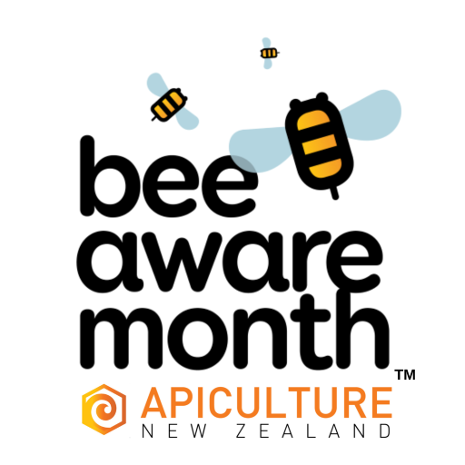
Information for teachers
The following slides include:
Basic information on plant pollination (slides 2-4)
Questions to get students thinking about the relationship between plants and flowers (slides 5,6)
Activities students can choose from to Explore, Make or Create, based on pollination and the relationship between bees and flowers (slides 7-9 and extra sheet)
Apiculture NZ School Art Competition information (slide 10 and extra sheet))

Slide 2
Pollination
Helping plants grow
Photo: Amanda Fleming

Slide 3
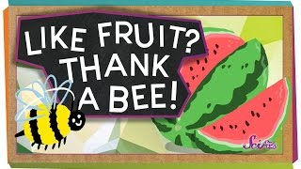
What is pollination?
Play the video to learn about pollination.

Slide 4
Bees and flowers are made for each other
Bees need flowers. Bees eat pollen and nectar made by flowers.
Plants need bees. Bees spread their pollen from one plant to another. By spreading pollen, plants can grow fruit and seeds to grow new plants.
This is called pollination.

Slide 5
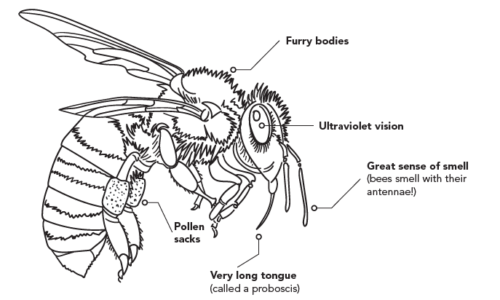
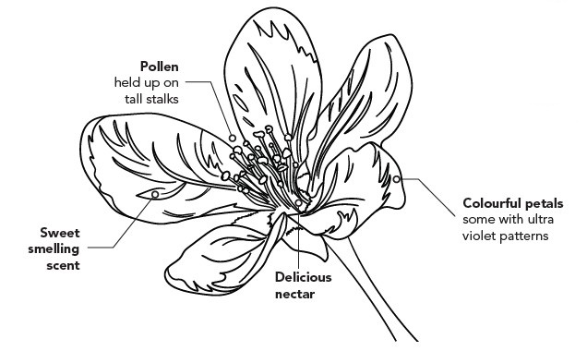
Bees and flowers are made for each other
Can you see three ways bees and flowers are made for each other?

Slide 6
Honey bee favourites
What kind of flowers do bees like?
Bees like pollen and nectar.
Bees need to get into the flower to get pollen and nectar.
Bees can see some colours better than others. They can easily see blue, purple, white and yellow.

Slide 7
EXPLORE
🌻Go for a walk around your school, backyard or neighbourhood.
What kind of flowers can you see?
What can you see inside the flowers?
Can you match any parts of flowers to the picture?
Which flowers do you think bees might like? Why?
Can you see any bees, birds or insects looking for food in any of the flowers?

Slide 8
MAKE
🌼Can you make or draw a flower that a honey bee would like?
Tip: look at the list of things bees like (slide 6) to help you decide what kind of flower to make.
You could use playdough, paper, lego or any other materials you can find.
You could try to make a kind of flower that you already know or you could invent a new kind of flower.
There are also flower templates on the next slide to get you started.

Slide 9
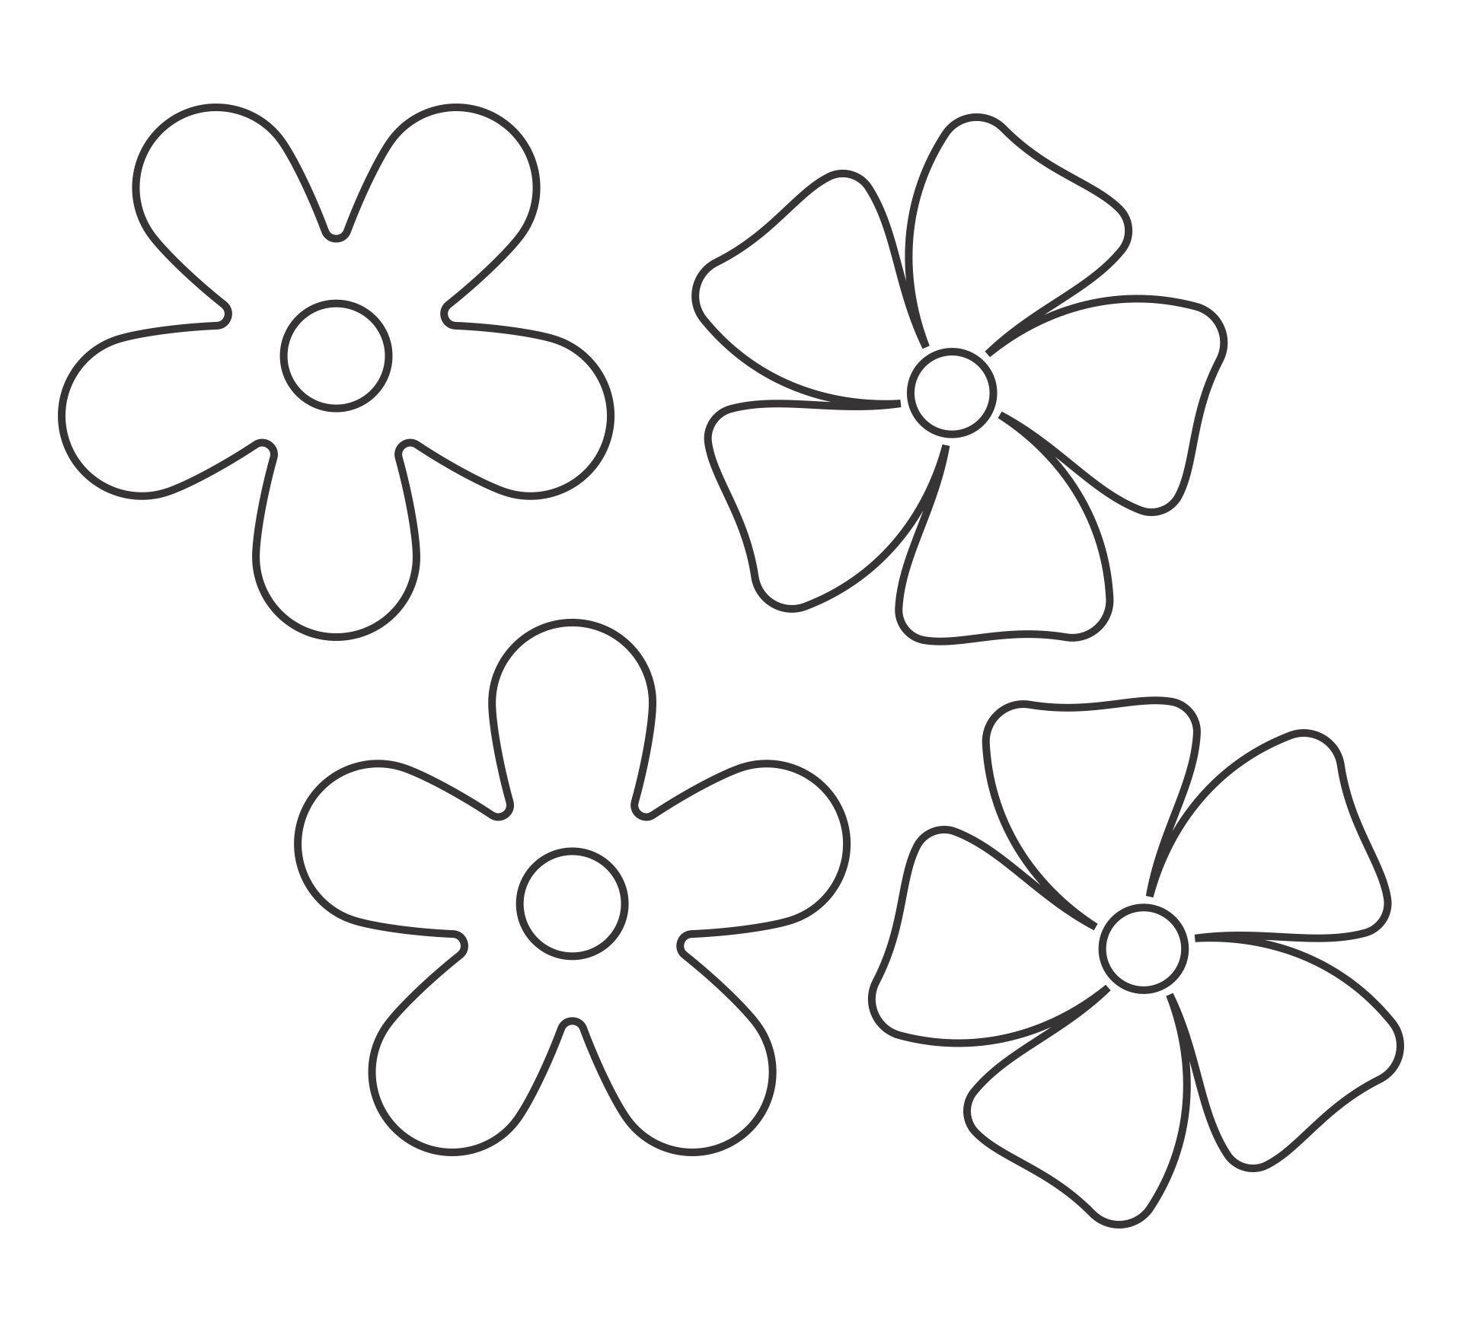

Slide 10
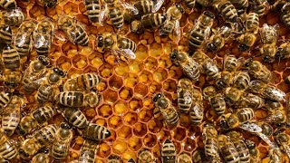
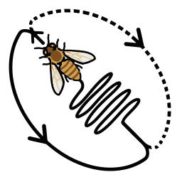
CREATE
Bees show other bees in their hive where the good flowers are by doing a special dance. It is called a Waggle Dance.
🕺 Can you make up a dance to show your classmates where to find good flowers or food at your school?
You could plan your dance by drawing a diagram like this one ➔
Don’t forget to show your classmates what each movement means before you do the dance.

Slide 11
ART COMPETITION
What would New Zealand look like without honey bees and other insects and animals that pollinate flowers (pollination)?
What plants wouldn’t grow anymore? What would we eat?
🍉Can you create a picture showing what New Zealand looks like with pollinators (animals that do pollination) and how it would look different without pollinators?
You can use the template provided to your teacher or your own paper.
Send your picture to Apiculture NZ for a chance to win a prize.

